Slide 1

Advanced Algorithms #1
Union/Find on Disjoint-Set Data Structures
Andrea Angella

Slide 2



Who I am?
Co-Founder of DotNetToscana
Software Engineer in Red Gate Software (UK)
Microsoft C# Specialist
Passion for algorithms
Mail: angella.andrea@gmail.com
Blog: andrea-angella.blogspot.co.uk

Slide 3
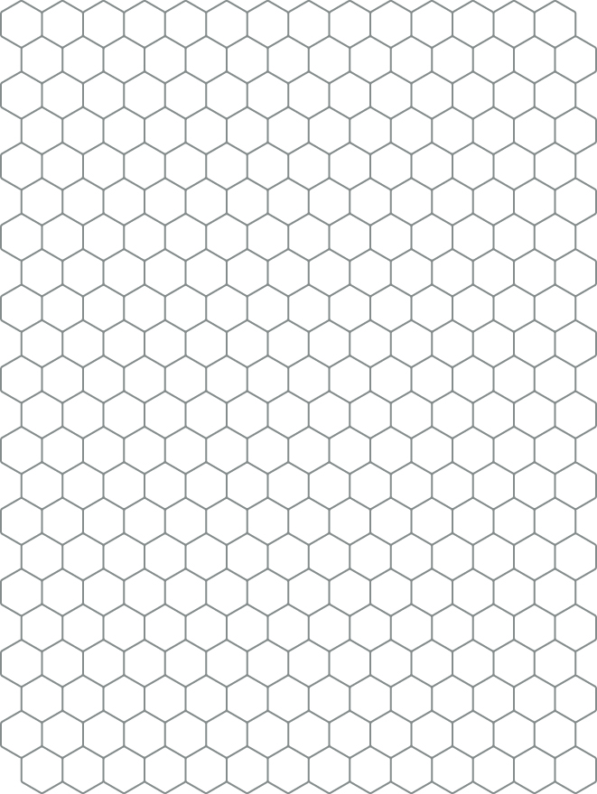

Agenda
Introduction to the series
Practical Problem: Image Coloring
The Connectivity Problem
5 different implementations
Image Coloring solution

Slide 4



Why learning algorithms?
To solve problems
To solve complex problems
To solve problems on big data sets
To become a better developer
To find a job in top software companies
To challenge yourself and the community
Lifelong investment
It is fun!

Slide 5

Why this series?
Practical (real problems and solutions)
Pragmatic (no mathematical proofs)
Algorithms are written from scratch in C#

Slide 6


Slide 7



Credits
Robert Sedgewick and Kevin Wayne
Algorithms 4 Edition
http://algs4.cs.princeton.edu/code/
Coursera:
https://www.coursera.org/course/algs4partI
https://www.coursera.org/course/algs4partII

Slide 8
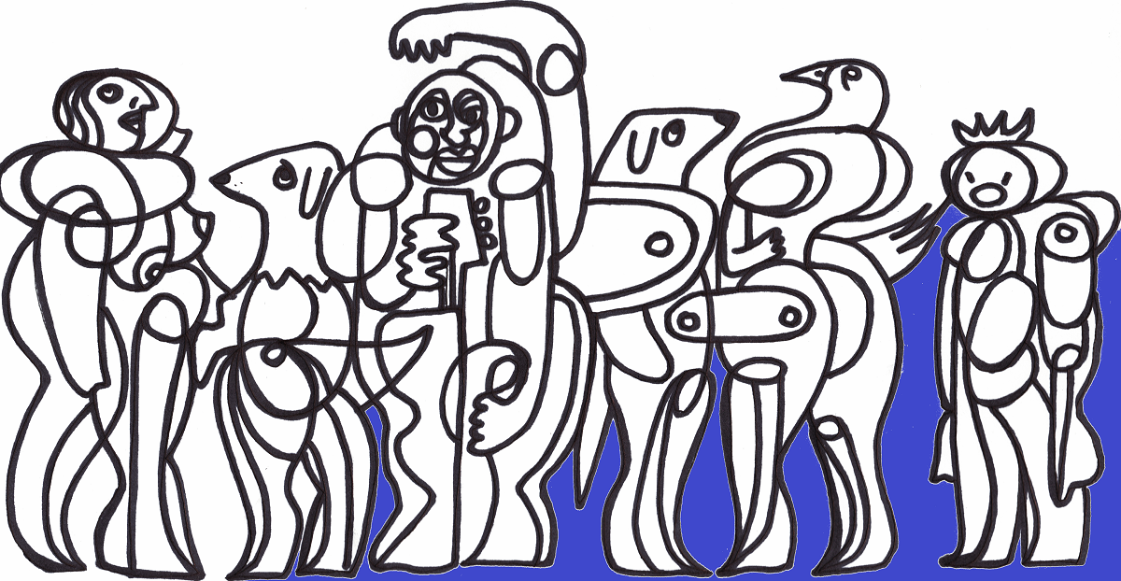
Problem: Image Coloring

Slide 9
Example

Slide 10
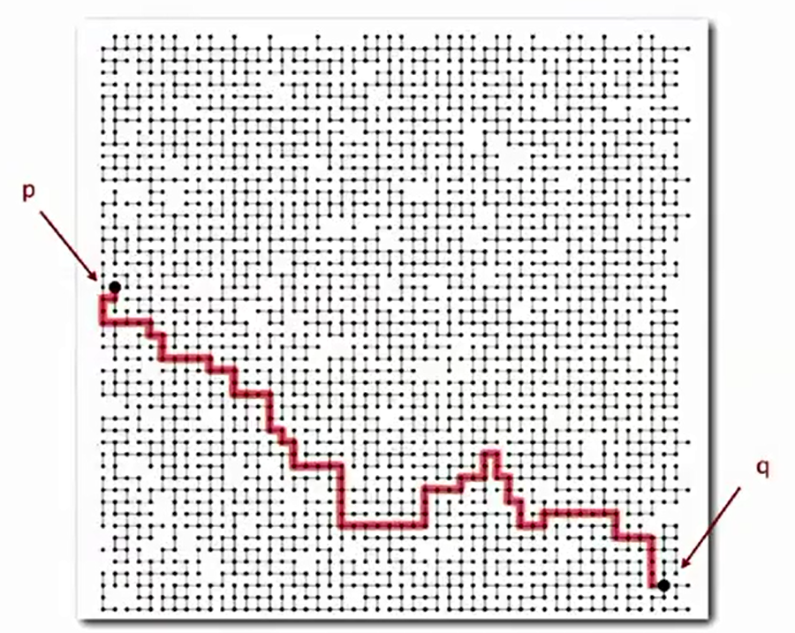
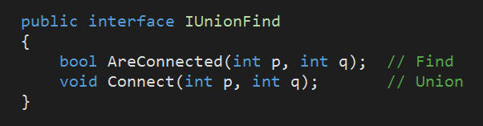
The Connectivity Problem

Slide 11
Example
N = 5
Connect (0, 1)
Connect (1, 3)
Connect (2, 4)
0
1
2
3
4
AreConnected (0, 3) = TRUE
AreConnected (1, 2) = FALSE

Slide 12
CODE

Slide 13
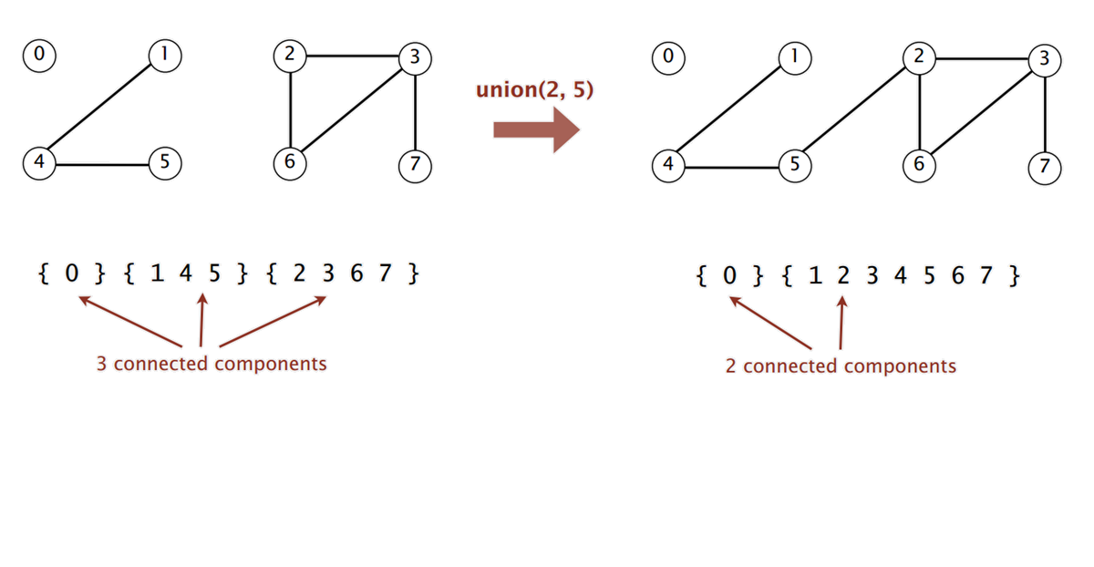
Connected Components

Slide 14
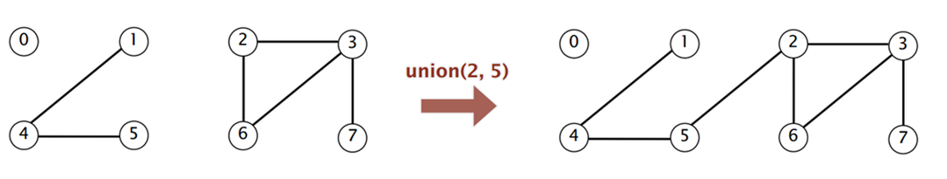
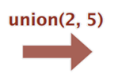
1) Quick Find
Assign to each node a number (the id of the connected component)
Find: check if p and q have the same id
Union: change all entries whose id equals id[p] to id[q]
0
1
2
3
4
5
6
7
0
1
2
3
4
5
6
7
id[]
0
1
2
2
1
1
2
2
id[]
0
1
1
1
1
1
1
1

Slide 15
CODE

Slide 16
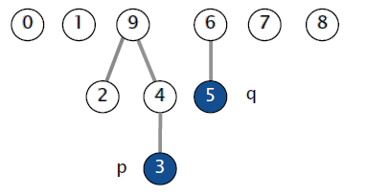
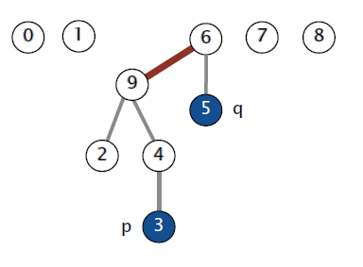
2) Quick Union
Assign to each node a parent (organize nodes in a forest of trees).
Find check if p and q have the same root
Union set the parent of p’s root to the q’s root
0
1
2
3
4
5
6
7
8
9
0
1
2
3
4
5
6
7
8
9
parent[]
0
1
9
4
9
6
6
7
8
9
parent[]
0
1
9
4
9
6
6
7
8
6

Slide 17
CODE

Slide 18
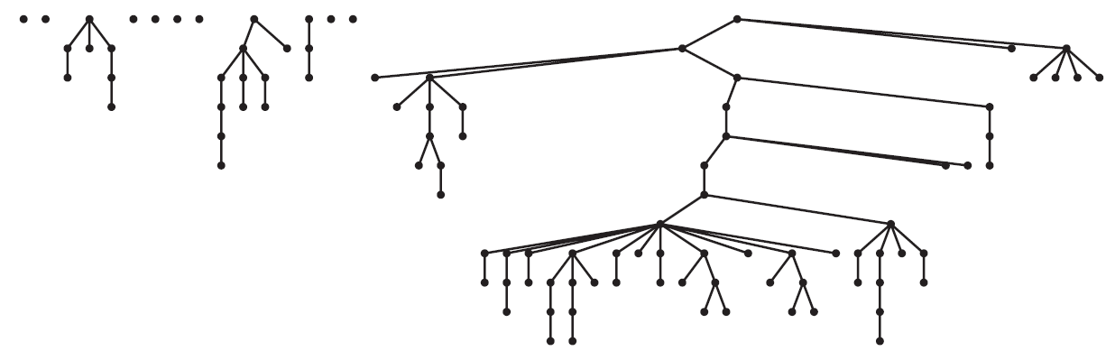
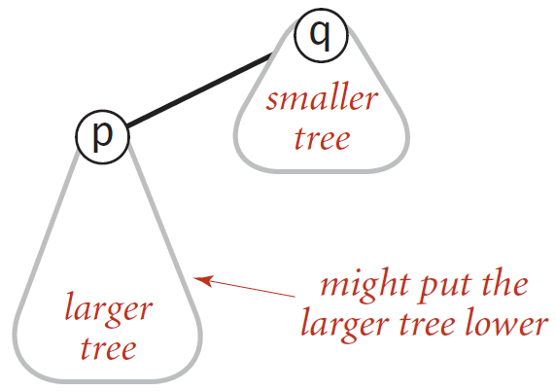
Why Quick Union is too slow?
The average distance to root is too big!

Slide 19
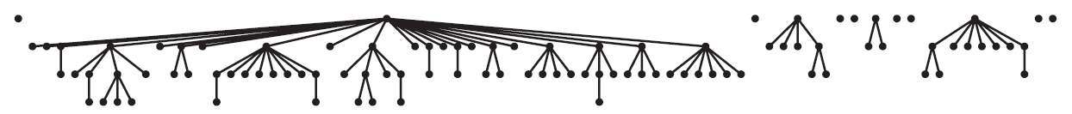
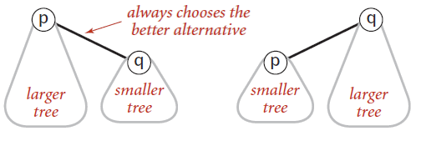
3) Weighted Quick Union
Avoid tall trees!
Keep track of the size of each tree.
Balance by linking root of smaller tree to the root of larger tree.

Slide 20
CODE

Slide 21
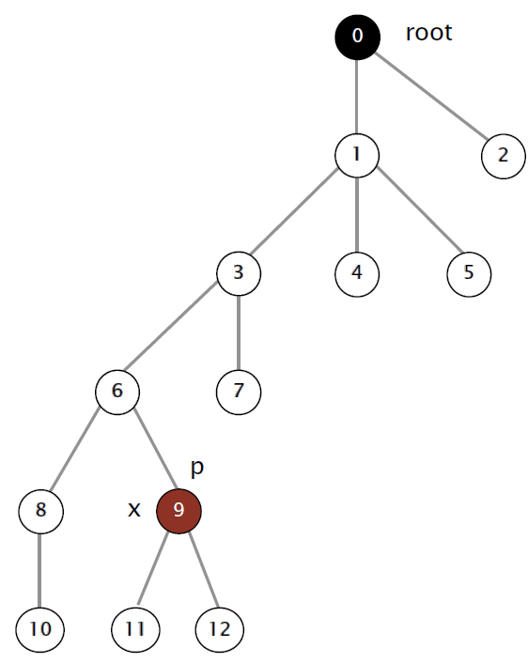
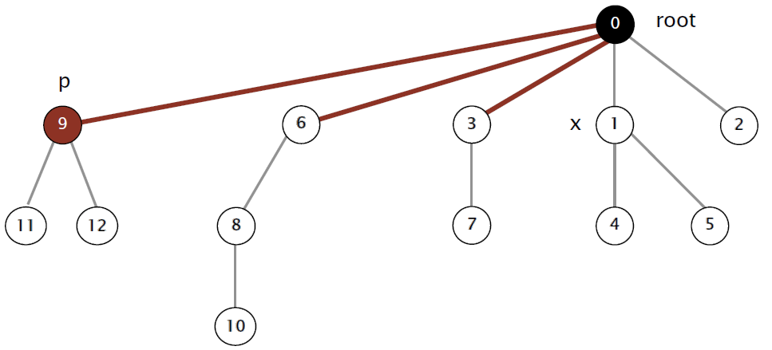
4) Quick Union Path Compression
After computing the root of p, set the id of each examined node to point to that root

Slide 22
CODE

Slide 23
5) Weighted Quick Union Path Compression
Weighted Quick Union
Quick Union Path Compression
+

Slide 24
Memory improvements
Keep track of the height of each tree instead of the size
Height increase only when two trees of the same height are connected
Only one byte needed to store height (always lower than 32)
Save 3N bytes!

Slide 25
CODE

Slide 26
Image Coloring Solution

Slide 27
CODE

Slide 28
Performance Analysis
Algorithm | Find | Union
Quick Find | N | N²
Quick Union | N² | N²
Weighted Quick Union | N Log N | N Log N
Quick Union Path Compression | N Log N | N Log N
Weighted Quick Union Path Compression | N Log* N | N Log* N
Linear Union/Find? | N | N
N | Log* N
1 | 0
2 | 1
4 | 2
16 | 3
65536 | 4
2⁶⁵⁵³⁶ | 5
[Fredman-Saks] No linear-time algorithm exists. (1989)
In practice Weighted QU Path Compression is linear!

Slide 29
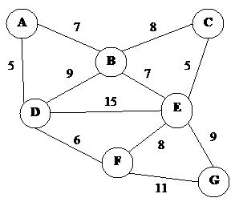
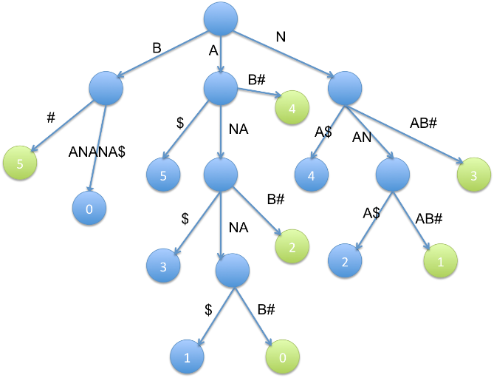
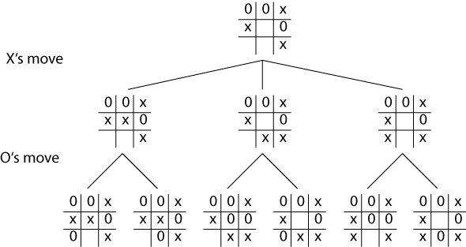
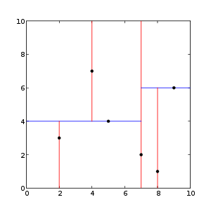
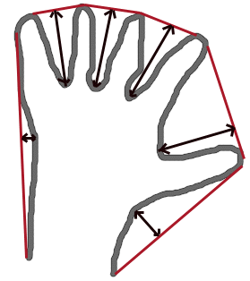
Don’t miss the next webcasts
Graph Search (DFS/BFS)
Suffix Array and Suffix Trees
Kd-Trees
Minimax
Convex Hull
Max Flow
Radix Sort
Combinatorial
Dynamic Programming
…

Slide 30
Thank you
https://github.com/angellaa/AdvancedAlgorithms

